Slide 1
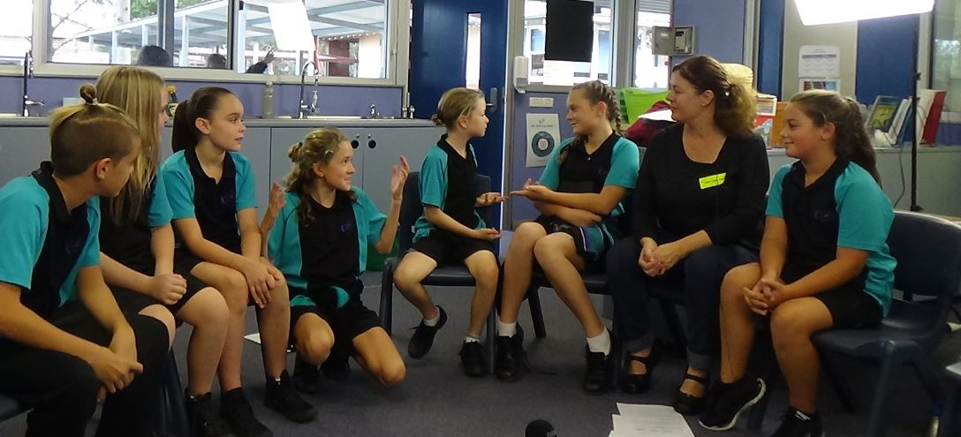
Ethics in the classroom
ETHICS FOR CHILDREN. SKILLS FOR LIFE

Slide 2
Introduction
Alternative during scripture period
Secular learning environment
Parents’ choice
Primary Ethics, a charity
Single approved provider
Train & provide all resources
Volunteers facilitate classes
Notes:
Thank you for giving me the opportunity to speak today about ethics classes. I am [name], title.
An alternative during scripture period for students not attending scripture class.
It is a secular learning environment for students of any faith or none.
A choice for parents what classes they would like their children to attend whether they are currently offered at the school or not).
Primary Ethics is the charity that creates the age-relevant curriculum and is the only approved provider of ethics education (SEE)
It provides all training and resources.
Volunteers just need to be willing to facilitate the classes and be comfortable working with children.

Slide 3
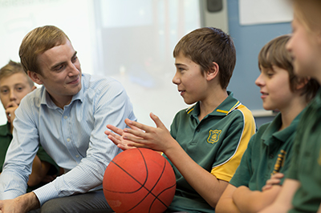
Mission
Support children to develop skills in
Ethical reasoning
Critical thinking
Respectful discussion
Notes:
Our mission is to support children to develop skills in ethical reasoning, critical thinking and respectful discussions.
Through Primary Ethics support & resources
And
Members of the school and broader communities working together to provide ethics education for children.

Slide 4
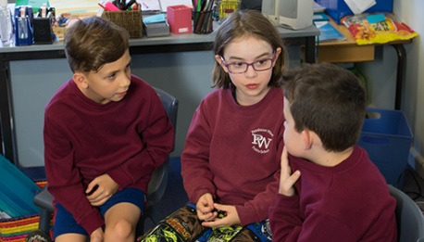
What do they learn?
Remain curious and open minded
Voice opinions & give reasons
Listen to others
Respectful discussion
Build on each
others’ ideas
Notes:
In ethics classes, children gain skills to assist them through life.

Slide 5
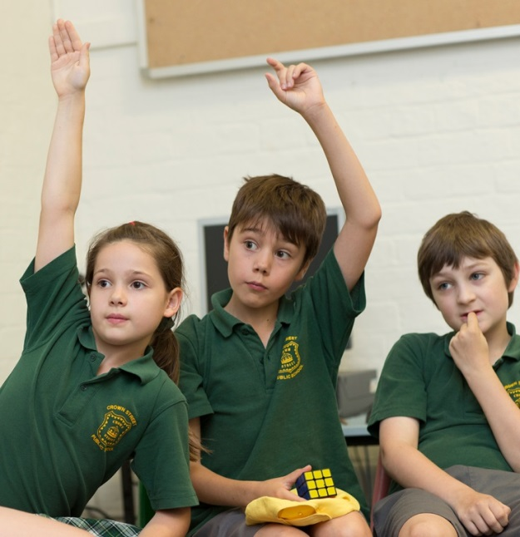
They also learn
To disagree respectfully
Not to accept peer pressure
And ultimately
To think things through
Make well reasoned
decisions
Notes:
They learn these skills through facilitated discussions around topics that are age-relevant to them.
The age-relevant curriculum is approved by the Department of Education.
Full lesson plans are provided and include all that the teacher will need for the class.

Slide 6
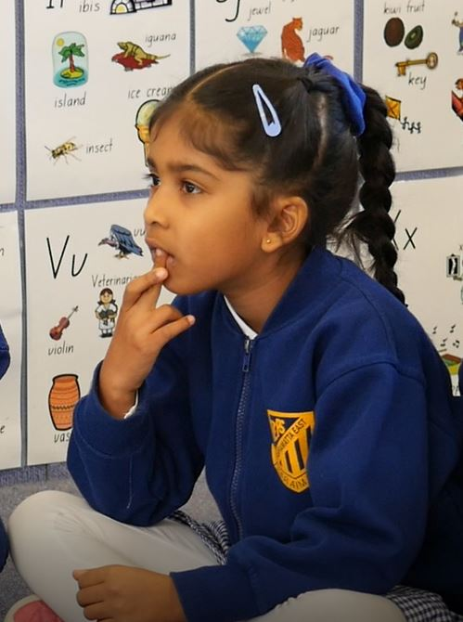
Lesson content
Scenarios
Poems
Stories
Group work
Activities
Questions
Age-specific
Notes:
Ethics classes include the above to encourage the children to think
about what people should do in different situations
about how different circumstances might make a difference and
about the consequences of actions.
The lessons are relevant for each stage, so kindergarten has its own curriculum, as does stages one, two and three.

Slide 7
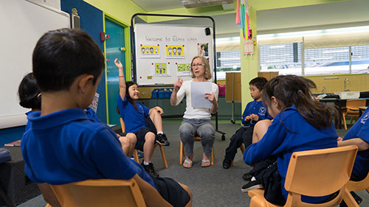
Sample topics
Infants (k – 2)
Hurting someone without meaning to
Telling the truth
Being kind
Ownership
Fairness
Primary (3 – 6)
What it means to be a good friend
Is cheating ever ok?
Punishment
Teasing

Slide 8
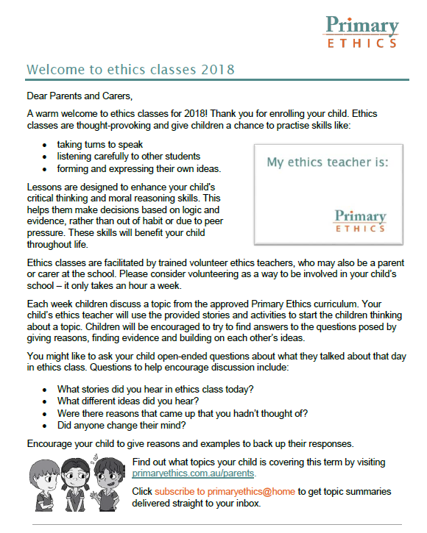
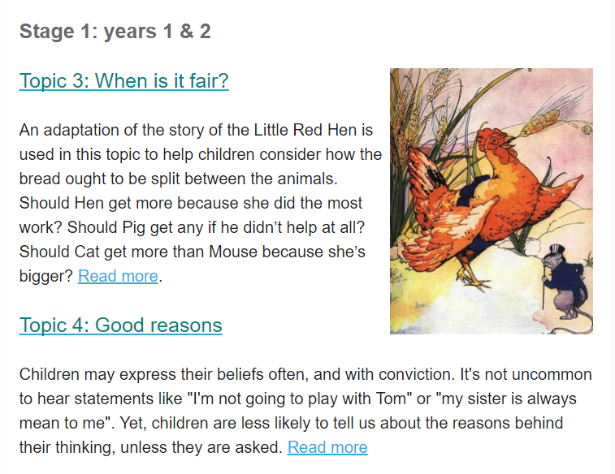
PrimaryEthics@Home
Parents subscribe at primaryethics.com.au for background to topics to help continue the discussion at home.

Slide 9
Community of inquiry
Facilitator
Detailed lesson
Children encouraged to
Ask questions of each other
Build on and challenge
each other’s ideas
Provide examples
Reason
Notes:
Volunteers are facilitators of the ‘Community of inquiry’ approach by following:
the detailed lesson without voicing their own opinions or views.
Children are encouraged to:
- (Follow slide) Ask questions of each other …

Slide 10
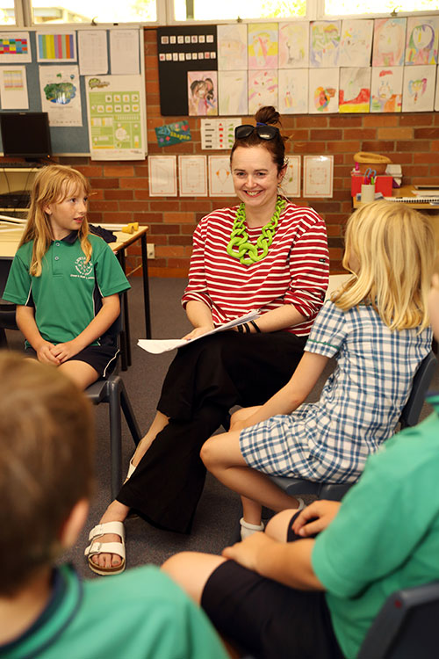
Facilitators
Volunteer ethics teachers
Teaching experience not required
Background checks
Online training module
Free 2 day face-to-face (and online) training
Ongoing support and
professional development
Notes:
Facilitators are volunteer ethics teachers.
To become a qualified volunteer ethics teacher:
- (Follow slide) Teaching experience not a requirement …

Slide 11
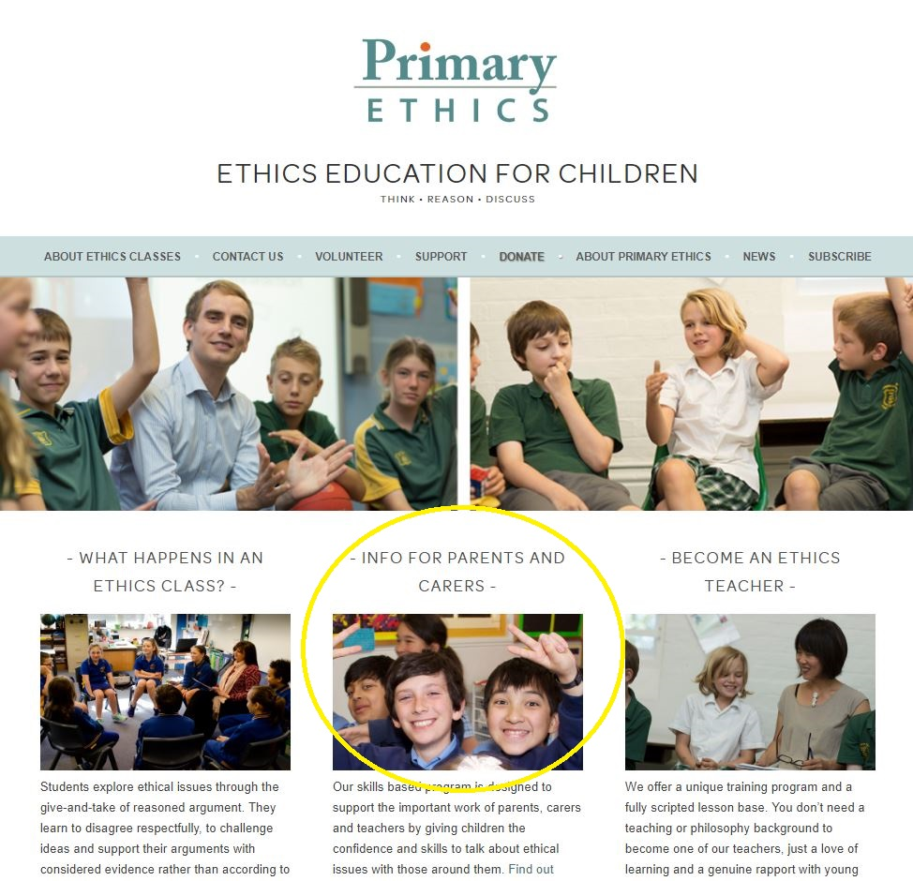
www.primaryethics.com.au

Slide 12
Local contacts
[Regional Manager/Ethics Coordinator]
Brochure available from school office
Available to answer questions after info session, or email/phone me
david.bartolo@tafensw.edu.au
0407 371338

